Slide 1
Conceptualizing and Building a Model

Slide 2
THE SIX RECOMMENDATIONS

Slide 3
The Six Recommendations
Balance
Only two branches after each chance node
No embedded decision nodes
The branches must be linked
The tree must have symmetry
Don’t worry about order

Slide 4
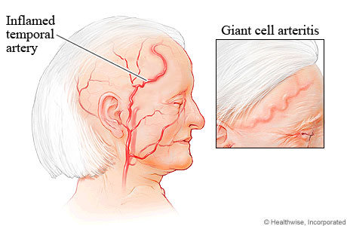
The Example: GCA
Giant cell arteritis (GCA):
  Vasculitis that affects large and medium-sized vessels, mostly in elderly patients.
  Symptoms may include headache, fever, and fatigue.
  GCA can lead to a very severe complication of blindness.
Interventions:
  Steroids are said to decrease the risk of blindness but come with the risk of side effects such as hypertension, fluid retention, and avascular necrosis of bone.
  Test for GCA, i.e., biopsy of the temporal artery, which can reveal vasculitis in the specimen. However, the sensitivity of that test is not ideal.
Focus on three strategies:
  - treating no patient with steroids
  - treating all patients with steroids
  - performing a temporal artery biopsy and treating positive cases only.

Slide 5
Principle #1: Balance
Tradeoff between risks and benefits
Strategies in tree must reflect this tradeoff
Example: Steroids for Giant Cell Arteritis
  Strategies:
    Steroids
    No Steroids
  “Balance sheet” of advantages / disadvantages

Slide 6
Benefits and Risks
Steroids
Benefit
  Prevent blindness
Risk
  Adverse outcome
No Steroids
Benefit
  No steroid effects
Risk
  Blindness

Slide 7
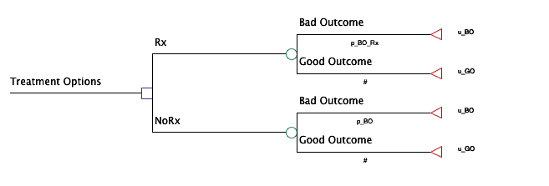
Is there balance?
Rx effective in preventing “Bad Outcome”.

Slide 8
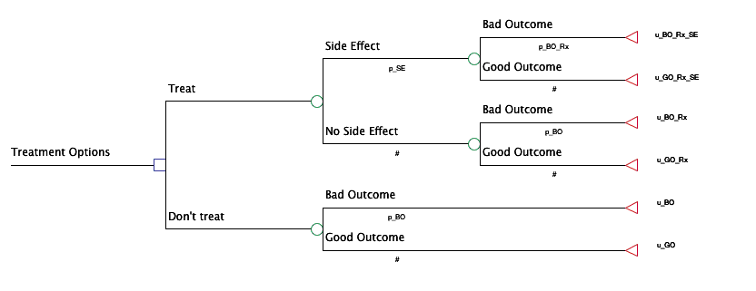
Is there balance?
Utilities capture side effects and treatment “hassle”
Side Effects included in tree

Slide 9
Principle #2: Only 2 branches
2 branches after each chance node
☒
☑
Death
Death
Blindness
Blindness
Alive
Alive not blind
Not blind

Slide 10
Rationale
Probabilities must be mutually exclusive
Probabilities must be exhaustive (sum to 1)
What happens if pDeath = 0.40 in sensitivity analysis?
Violates above rule!
Rule easily enforced if only 2 branches
Death
pDeath = .05
Blindness
pBlind = .80
Alive not blind
pNotBlind = .15

Slide 11
Beware conditional probabilities!
Death
Death
pDeath
Blindness
Alive
pBlind / (1-pDeath)
#
Not blind
=1-pDeath
#
= pNotBlind / (1-pDeath)

Slide 12
Limits to Sensitivity Analysis
Max probability of Blindness ≠ 1; = 1/(1-pDeath)
Requires changing pDeath (=0) before can analyze pBlind=1
Death
Death
pDeath
Blindness
Alive
pBlind / (1-pDeath)
#
Alive not blind
#

Slide 13
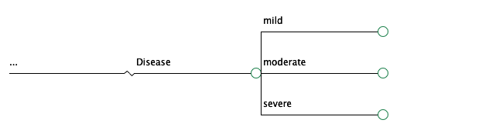
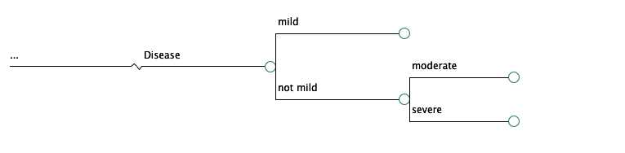
Another example
☒
☑

Slide 14
Principle #3: No embedded decision nodes
☒
☑
Test+ → Rx
Test
Rx All
Test- → Rx
Test+ → Rx
Test
Test- → Rx
Rx All
No Test
Rx None
Rx None

Slide 15
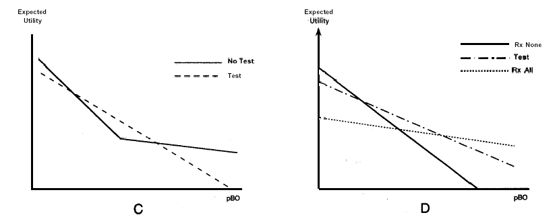
Sensitivity Analysis
(occurrence of adverse event without therapy)
☒
☑

Slide 16
Principle #4: Link branches
Use 1 variable name for 1 event
Use effect modifier to change events in different branches

Slide 17
Modeling Effects
Let’s say we have a bad outcome
With an associated probability
We know the probability of the bad outcome without treatment; let’s call it pBO
Two ways to consider modeling the probability of the bad outcome with treatment
  Another variable, pBORx
  “Modify” pBO → pBO * m

Slide 18
Modifying the baseline risk is better
  Why?
    Conceptually, think of these as not independent
    Practically, the data you will find in the literature
  When effect is the relative risk reduction (e)
    m = 1-e
  When effect is the relative risk (r)
    m = r
  Even better to work with odds and odds ratios
  Or hazards and hazard ratios
  We’ll discuss in another lecture
Notes:
Odds ratio (unlike relative risk) treats the two variables compared symmetrically, and can be estimated using some types of non-random samples.

Slide 19
☒
☑
Bad Outcome
Bad Outcome
Rx None
pBO
Rx None
pBO
Good Outcome
Good Outcome
#
#
Side Effect
Side Effect
Bad Outcome
pSE
Bad Outcome
pSE
pBORx
No Side Effect
pBO*(1-e)
No Side Effect
Rx All
#
Rx All
#
Side Effect
Side Effect
Good Outcome
pSE
Good Outcome
pSE
#
No Side Effect
#
No Side Effect
#
#

Slide 20
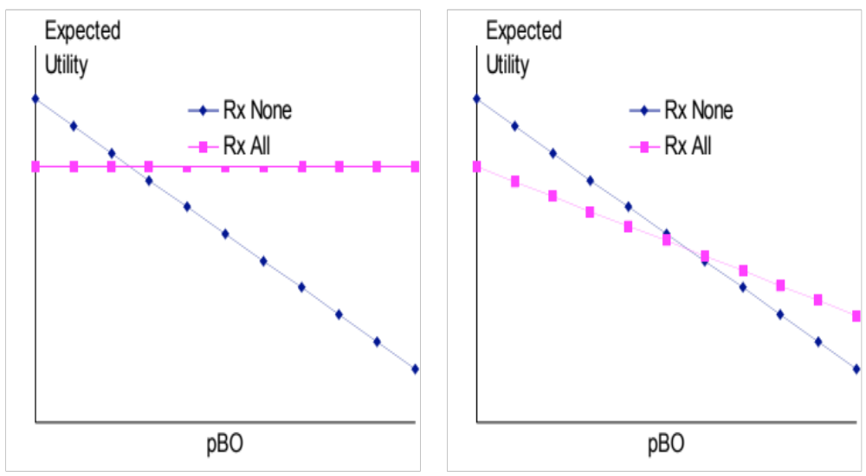
Sensitivity Analysis
(probability of bad outcome without Rx)
☒
☑

Slide 21
Principle #5: Symmetry
All initial health states that could affect outcomes represented in all branches
Portions of tree repeated
Subtrees, clones
Easier
  Sensitivity analysis
  Debugging
Learn to use bindings

Slide 22
Symmetry
Same subtree repeated for RxA and RxB
Side Effect
Bad Outcome
pSE
(=pSEA)
pBO*(1-e)
No Side Effect
Rx A
(=pBO*(1-eA)
#
Values of “e” and “pSE” bound to the left of their use
e=eA
pSE=pSEA
Side Effect
Good Outcome
pSE
(=pSEA)
#
No Side Effect
#
Side Effect
pSE
(=pSEB)
Bad Outcome
pBO*(1-e)
No Side Effect
Rx B
(=pBO*(1-eB)
#
e=eB
pSE=pSEB
Side Effect
Good Outcome
pSE
(=pSEB)
#
No Side Effect
#

Slide 23
Principle #6: Order not important
Side Effect
Bad Outcome
Bad Outcome
pSE
Side Effect
pBO*(1-e)
pBO*(1-e)
No Side Effect
pSE
Good Outcome
Rx
#
=
Rx
#
Side Effect
Bad Outcome
Good Outcome
pSE
No Side Effect
pBO*(1-e)
#
No Side Effect
#
Good Outcome
#
#
Notes:
Doesn’t matter b/c:
mathematically, folding back the tree is equivalent to multiplying all of the probabilities along the branches until one obtains the probability of being in each state of the terminal node.

Slide 24
Ordering
Advantages
  Make best use of available data
Disadvantages
  Looks

Slide 25
CONCEPTUALIZING A MODEL/ ECONOMIC EVALUATION
Notes:
Based on: https://www.cadth.ca/dv/guidelines-economic-evaluation-health-technologies-canada-4th-edition

Slide 26
Roadmap
Reality
Data sources
Conceptualization
Decision problem/
Disease
Model Output
Model
Stakeholders
Example: Invasive meningococcal disease
Adapted from Roberts 2012

Slide 27
INVASIVE MENINGOCOCCAL DISEASE
A Case Study

Slide 28
Invasive Meningococcal Disease (IMD)
IMD:
  Acute and serious communicable disease caused by the bacterium Neisseria meningitidis,
  Clinical manifestations: meningitis, septicemia (meningococcemia) or both.
  Case fatality ratio: 5-11%
  Sequelae in ~1/3 of survivors, including hearing loss, neurologic disabilities, and digit or limb amputations
  Most frequent serogroups associate with IMD: A, B, C, W-135 and Y
Serogroup B meningococcal (MenB) disease
  Endemic in Ontario
  Most common cause of life-threatening IMD in children

Slide 29


Notes:
http://www.comomeningitis.org

Slide 30
Vaccines
Most frequent serogroups associate with IMD: A, B, C, W-135 and Y
Current vaccines:
  Men C: 12 months of age
  Men ACYW-135 vaccine: 7th grade
MenB?
  A novel MenB vaccine was submitted for regulatory approval in Europe, Australia and Canada (Spring 2011).

Slide 31
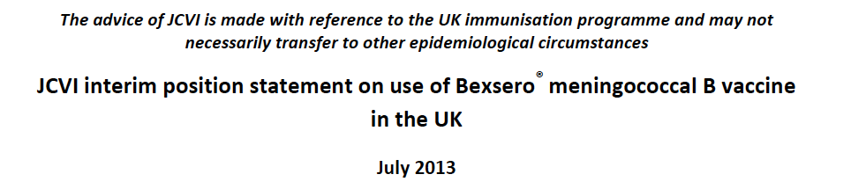
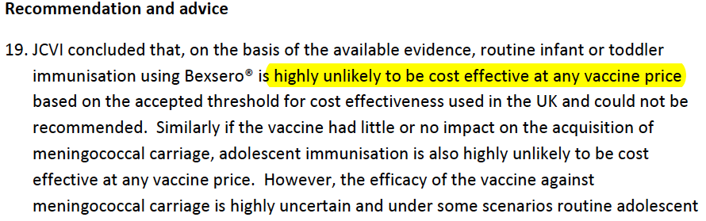
Notes:
http://www.hc-sc.gc.ca/dhp-mps/prodpharma/sbd-smd/drug-med/sbd_smd_2014_bexsero_147275-eng.php

Slide 32
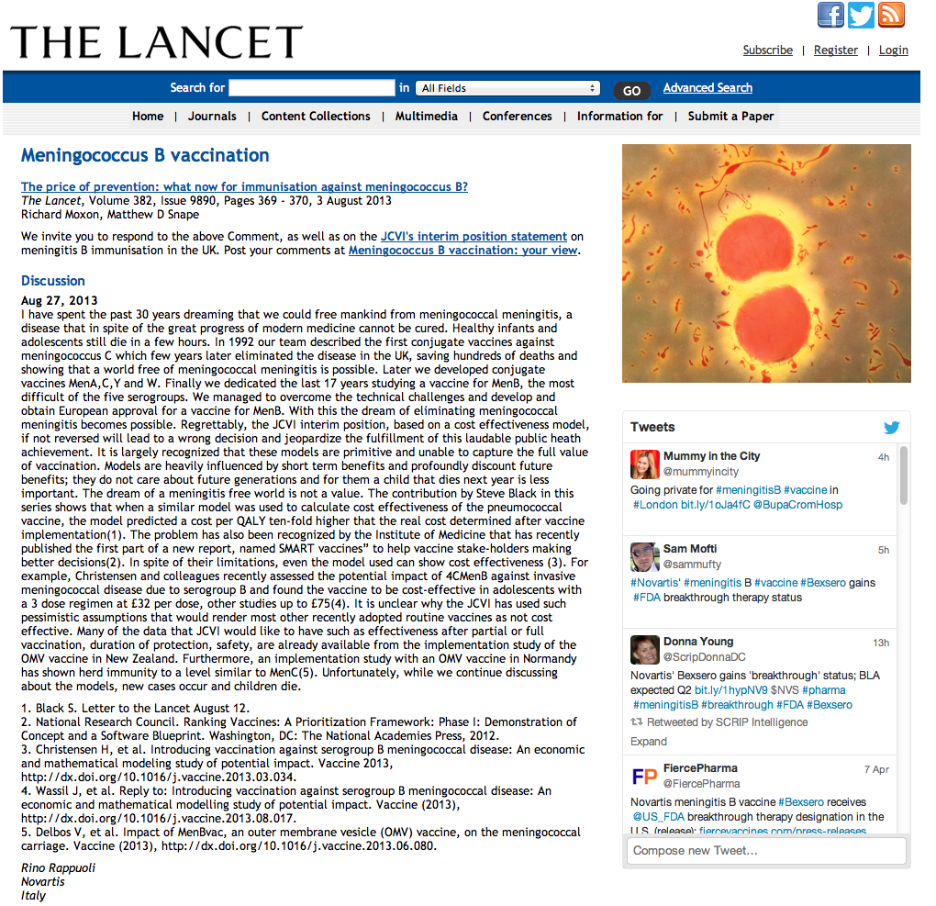
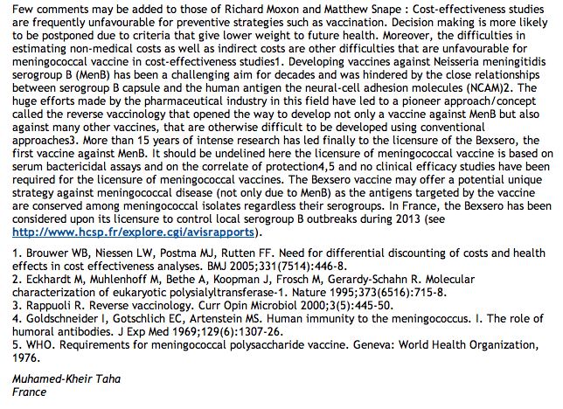
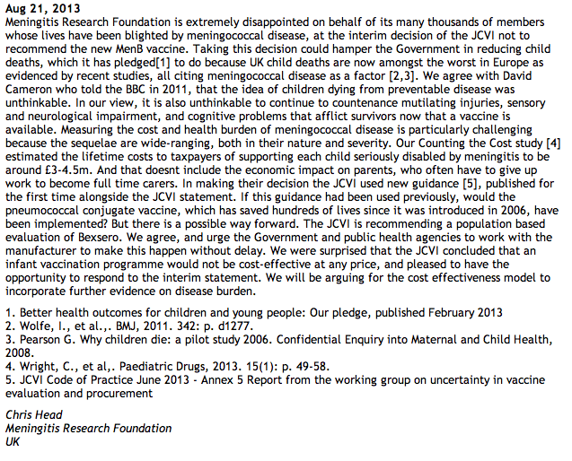

Slide 33
You are a member of the National Advisory Committee on Immunization.
At a recent meeting the committee was informed about a new MenB vaccine that is currently under development and appears to be safe and effective.
Anticipating that the vaccine may be approved for use in Canada within the next 2-3 years, the committee is interested in exploring the potential cost-effectiveness of the new vaccine in the Canadian context to support timely decision-making.

Slide 34
Conceptualizing the Problem
Reality
Data sources
Conceptualization
Decision problem/
Disease
Model Output
Model
Stakeholders
Example: Invasive meningococcal disease
Adapted from Roberts 2012

Slide 35
Conceptualizing the Problem
Decision problem/decision objective
Policy context
Considerations:
Strategies
Tradeoffs
Perspective
. . .

Slide 36
Decision Problem
Decision analysis/economic evaluation: designed to inform decisions (not to test hypotheses) → necessary to specify the decision problem.
Good practice to specify the decision problem in consultation with clinicians, members of the affected population, and the decision-maker(s).
Notes:
Economic evaluation: designed to inform decisions (not to test hypotheses) → Necessary to specify the decision problem for designing an appropriate economic evaluation.
Good practice to specify the decision problem in consultation with clinicians, members of the target population, and the decision-maker(s) to ensure that all relevant comparators are included; the most relevant outcomes for each stakeholder are taken into account; and the assessment is founded on a thorough understanding of all available evidence.

Slide 37
Strategies
Infant vaccination program
(Vaccination for specific population groups)
No infant vaccination program

Slide 38
Strategies and Tradeoffs
Vaccinate
Don’t vaccinate

Slide 39
Strategies and Tradeoffs
Vaccinate
  Cost (disadvantage)
  Prevent potentially deadly disease
  Prevent serious long-term sequelae
  Equality (access to expensive vaccine)
  Protection of vulnerable population groups
  Duration of protection unclear
  Herd immunity effects unclear
  Adverse events from vaccine
  Vaccine “fatigue”
Don’t vaccinate
  No vaccination cost
  Access depends on ability to pay
  No risk of adverse events
  No protection from low incidence but potentially very severe disease

Slide 40
Let’s consider these outcomes
Costs
Benefit from vaccination
Risk of adverse events

Slide 41
MenB Vaccine
 | Vaccinate | Don’t Vaccinate
Costs
Benefit from vaccination
Risk of adverse Events

Slide 42
MenB Vaccine
 | Vaccinate | Don’t Vaccinate
Costs | Cost | No cost
Benefit from vaccination | Potential | No Potential
Risk of adverse Events | Risk | No Risk

Slide 43
Conceptualizing the Model
Reality
Data sources
Conceptualization
Decision problem/
Disease
Model Output
Model
Stakeholders
Example: Invasive meningococcal disease
Adapted from Roberts 2012

Slide 44
Conceptualizing the Model
Decision problem/decision objective
Type of economic evaluation
Disease
Scope and structure
Analytic perspective
Target population
Interventions/comparators
Outcomes (health, cost)
  → Effectiveness, measurement and valuation of health, resource use and cost
Time horizon

Slide 45
Conceptualizing the Model
Decision problem
Type of EE
Disease
Scope and structure
Analytic perspective
Target population
Comparators
Outcomes
Time horizon

Slide 46
Conceptualizing the Model
Decision problem | To determine whether to fund a MenB vaccination program
Type of EE | Cost-utility analysis
Disease | Invasive MenB disease
Scope and structure | Single disease, simple decision tree (for today)
Analytic perspective | Healthcare payer (for today)
Target population | Children
Comparators | Vaccination, no vaccination
Outcomes | Costs, benefit from vaccination, adverse events
Time horizon | Lifetime

Slide 47
Objective
Comparator
Type of evaluation
Target population
To assess the cost-utility of meningococcal serogroup B vaccination in infants compared to no vaccination from the healthcare payer perspective in Canada.
Comparator
Perspective
Also helpful: PICO(PS)
Population, Intervention, Comparison, Outcome, Perspective, Setting

Slide 48
Modeling
→ Framework for synthesizing available data and assumptions from multiple sources to generate estimates of the expected costs and outcomes for the interventions of interest.

Slide 49
Model Structure I
→ Defined by specific states or events and the relationships among them that together constitute the clinical or care pathway for the condition of interest and the interventions being compared.

Slide 50
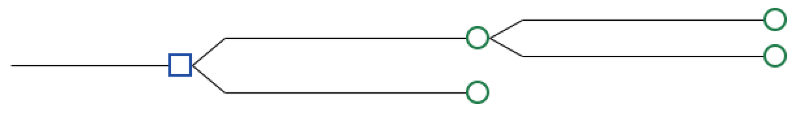
Model Structure II
Clinical pathway:
  Invasive meningococcal disease history (progression without intervention/current standard of care)
  Events related to intervention that modify disease history: intervention effectiveness/adverse events
Care pathway:
  Doctor’s visits, hospitalizations
  Care related to intervention

Slide 51
Model Structure III
Address the decision problem
Clinically relevant, i.e.,
  consistent with the current knowledge of the biology of the health condition, the causal relationships among variables that constitute the clinical or care pathway, and the expected effects of the interventions (Briggs A 2006).
Not dictated by the availability of data
  In practice, the availability of data may constrain the options in model development.
Challenge: determining an adequate level of detail.
  The model should be conceptualized in such a way that it provides a representation of reality that captures the elements and relationships that are essential to address the decision problem, but should not be more complex than is required (Stahl JE 2008).
Notes:
Briggs A, Claxton K, Sculpher M. Decision modelling for health economic evaluation. Oxford (GB): Oxford University Press; 2006.
Stahl JE. Modelling methods for pharmacoeconomics and health technology assessment: an overview and guide. Pharmacoeconomics. 2008;26(2):131-48.

Slide 52
INVASIVE MENINGOCOCCAL DISEASE
A Case Study

Slide 53
Tree Construction
Construct the tree
Fold it back
Sensitivity Analysis

Slide 54
Events
Adverse events
  Adverse outcome for infant (febrile seizure)
Invasive MenB disease
  Survive, no sequelae
  Survive, sequelae
  Die of acute disease

Slide 55
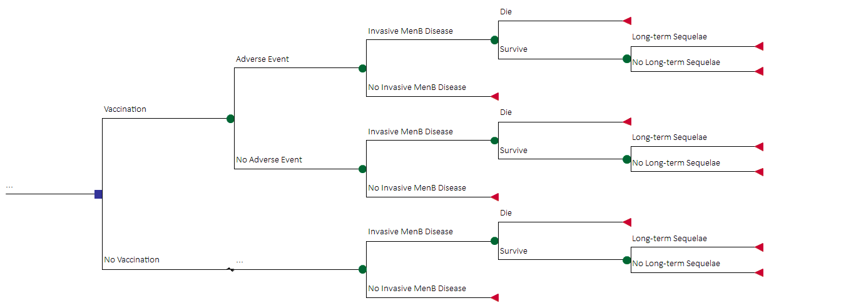
Invasive MenB Disease Example

Slide 56
Probabilities
 | Base Case Value | Range for SA
Adverse event | 0.002 | 0 - 0.01
Invasive MenB disease | 0.000007 | 0.000007 - 0.00007
Acute death | 0.1 | 0.05 - 0.12
Long-term sequelae given survival of acute disease (major) | 0.05 | 0.02 - 0.06
Vaccine effectiveness (includes vaccination coverage, strain coverage and efficacy) | 0.58 | 0.31 - 0.77
Assume
Mean age of invasive MenB disease is 5 years
Life expectancy is 80 years

Slide 57
Invasive MenB Disease Example
Clone!

Slide 58
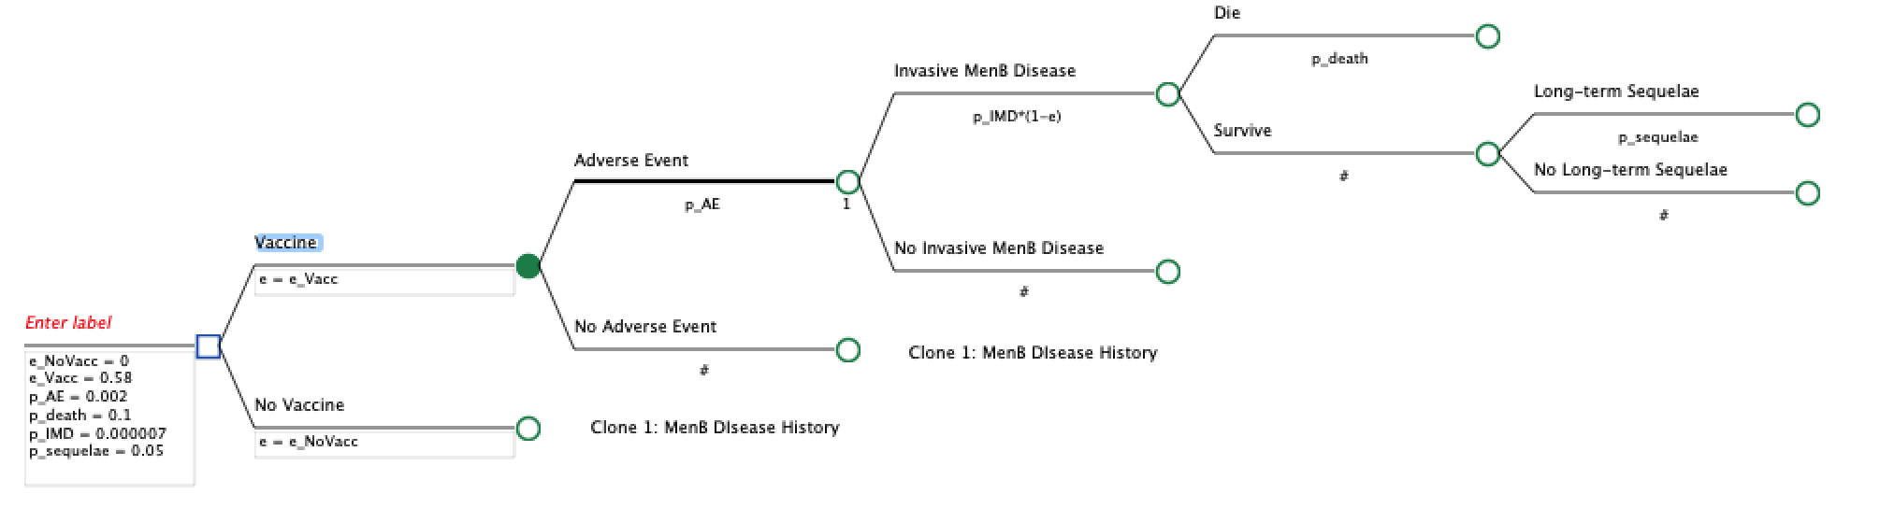
Invasive MenB Disease Example
Clones
e = e_Vacc
e = e_NoVacc

Slide 59
Outcomes
 | Base Case Value | Range for SA
Utility, Adverse event | 0.9996 | 0.98-1
Utility, Invasive MenB disease | 0.87 | 0.5-1
Utility, Long-term sequelae | 0.78 | 0.38-1
Utility, Well | 1
Utility Death | 0
Cost, Vaccination | $300 | $100 - $400
Cost, Adverse event | $673 | $51 - $5,847
Cost, Invasive MenB disease (acute) | $16,630 | $4,484 - $28,416
Cost, Long-term sequelae (per year) | $12,256 | $3,360 - $46,356

Slide 60
Invasive MenB Disease Example
Results
Strategy | Cost | Incremental Cost | Effectiveness | Incremental Effectiveness
No Vaccination
Vaccination
Incremental Cost-Effectiveness Ratio (ICER): $ / QALY

Slide 61
To do for next week
Do a thorough search to make sure that nobody else has answered your question already
Start thinking about strategies and trade-offs for your question

